Slide 1

Library Management System
Professor : Siamak Tavakoli
MPP Final project

Slide 2
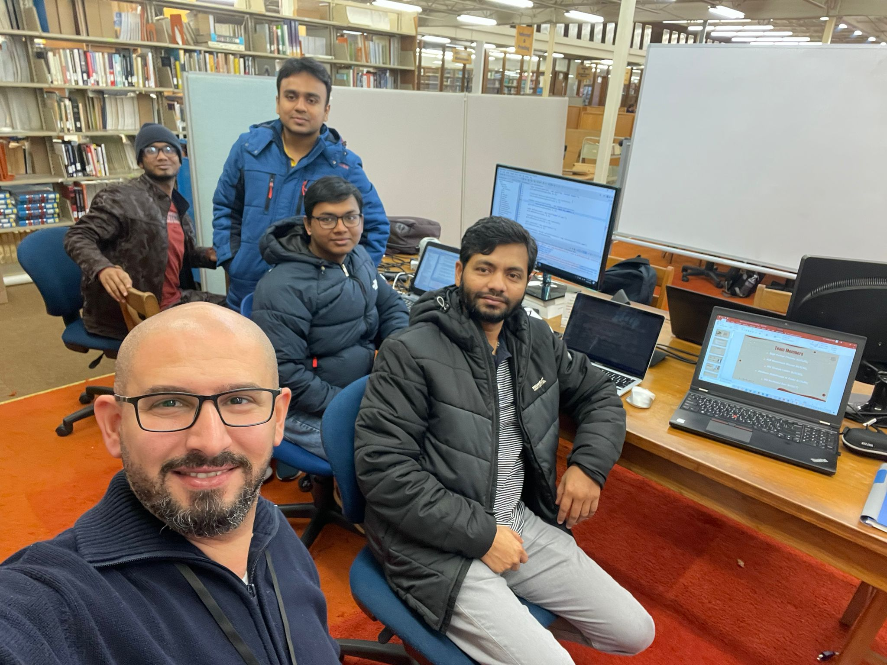
Team Members
Sujit Chanda (615185)
Asif Miazee (615156)
Md Shahab Uddin (615180)
Hesham Al Zoubi (615189)
Md Rashedul Bari (615217)

Slide 3
Requirements
Objective is to create a library management system that a librarian can use to checkout books for library members, on the other hand, an administrator can use to add new books to the collection, create new library members, and edit library member information.
In order to access the system, a librarian or administrator must log in where Administrator and Librarians will have different roles.
All the members are stored along with their basic information along with address to track the book checkout and other life cycle. Same for books and also the checkout records. Most books may be borrowed for 21 days, but some books are only for 7 days.

Slide 4
Requirements
The library can have a book with at least one copy, or multiple copies of some popular books. Every copy of a book has its own unique copy number.
The checkout record for a library member is a complete record of every book that the member has ever checked out. Each entry records each item checked out, the date of checkout, and the due date.

Slide 5
PROJECT EXECUTION STEPS
1
2
3
4
5
6
Analysis
Analysis
Analysis
Analysis
Design
Implementation
Add
Relationships
to the
Static Model
Enhance the Static and Dynamic Models
User Requirements
Create
a Static Model
Transform
UML into
Code
Create a
Dynamic Model

Slide 6

Use Cases Diagram
01
Main Requirements

Slide 7
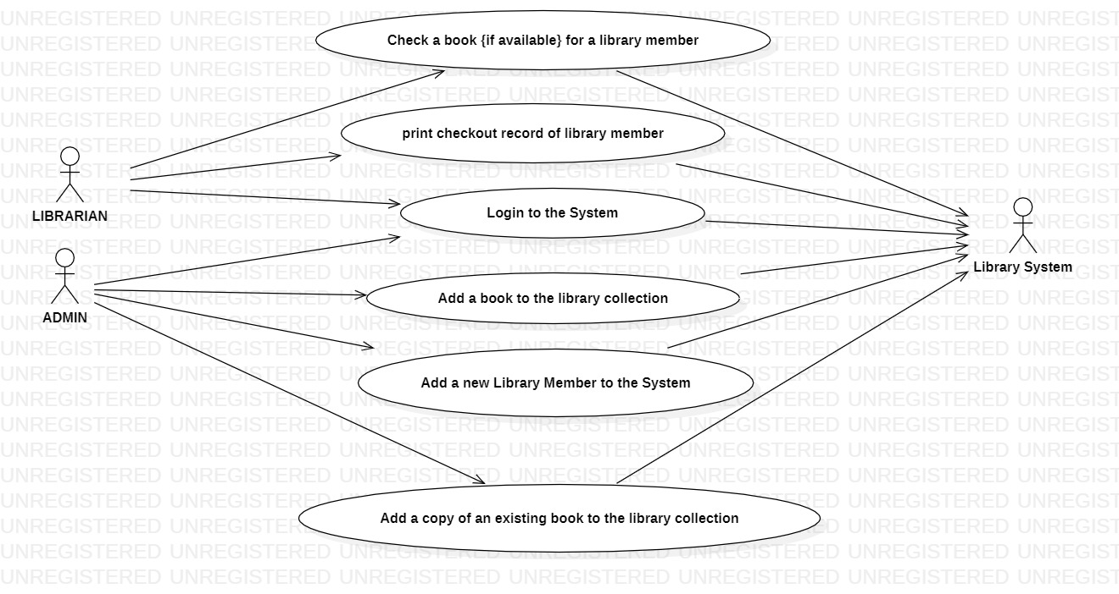
Optional
Use Case (2)
Optional
Use Case (1)

Slide 8
Class Diagram
02
Including Relations

Slide 9
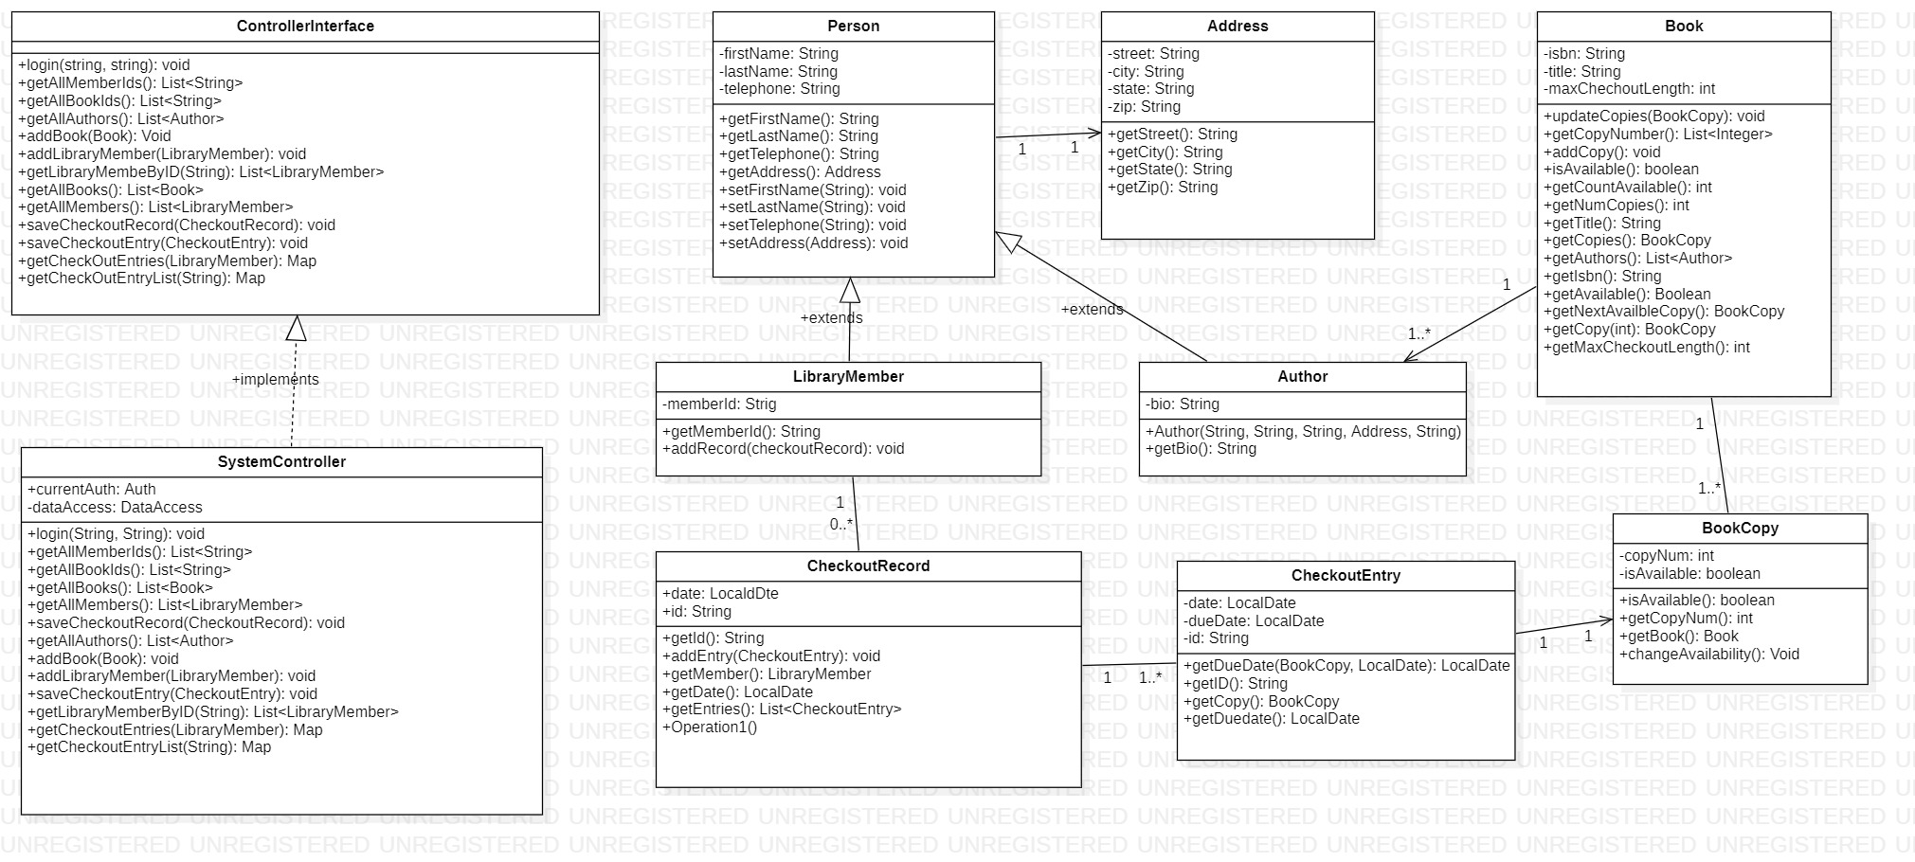

Slide 10
Sequence Diagrams
03

Slide 11
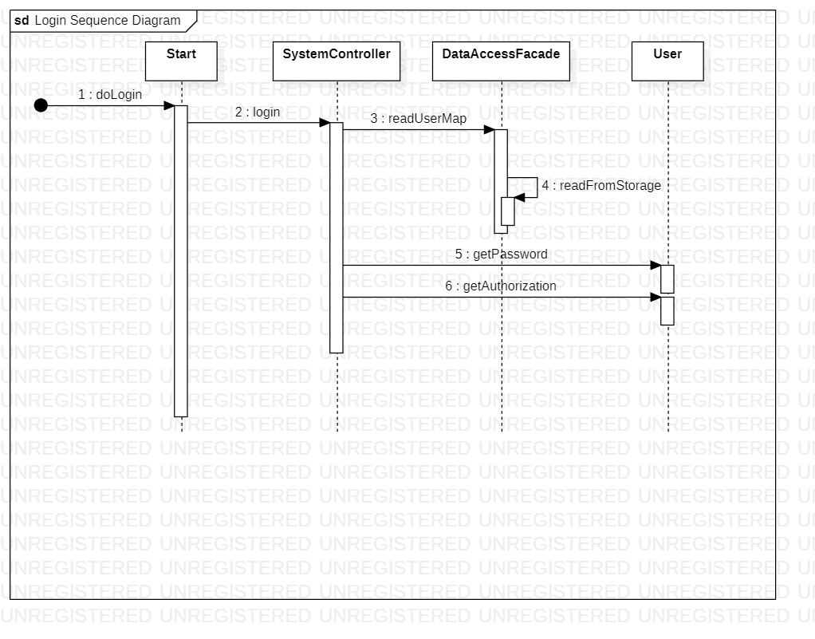

Slide 12
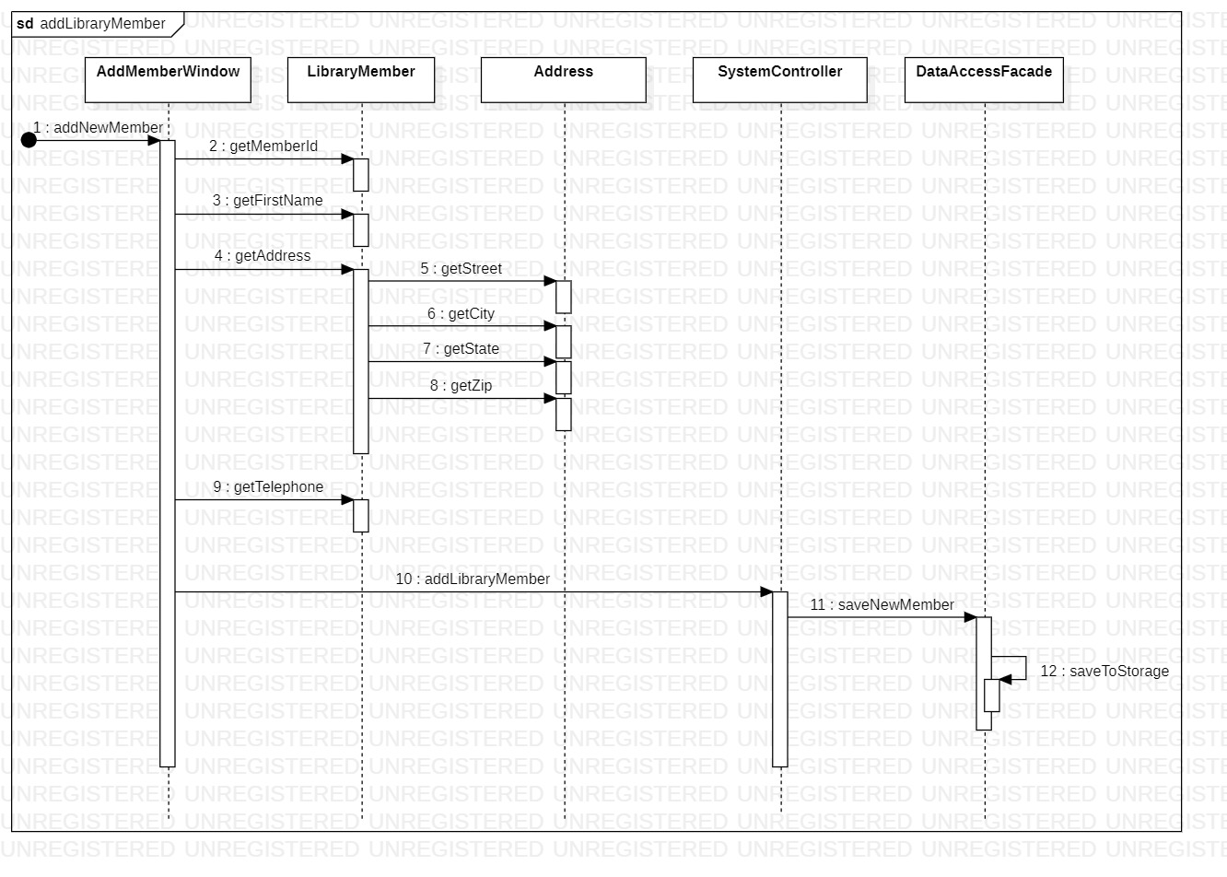

Slide 13
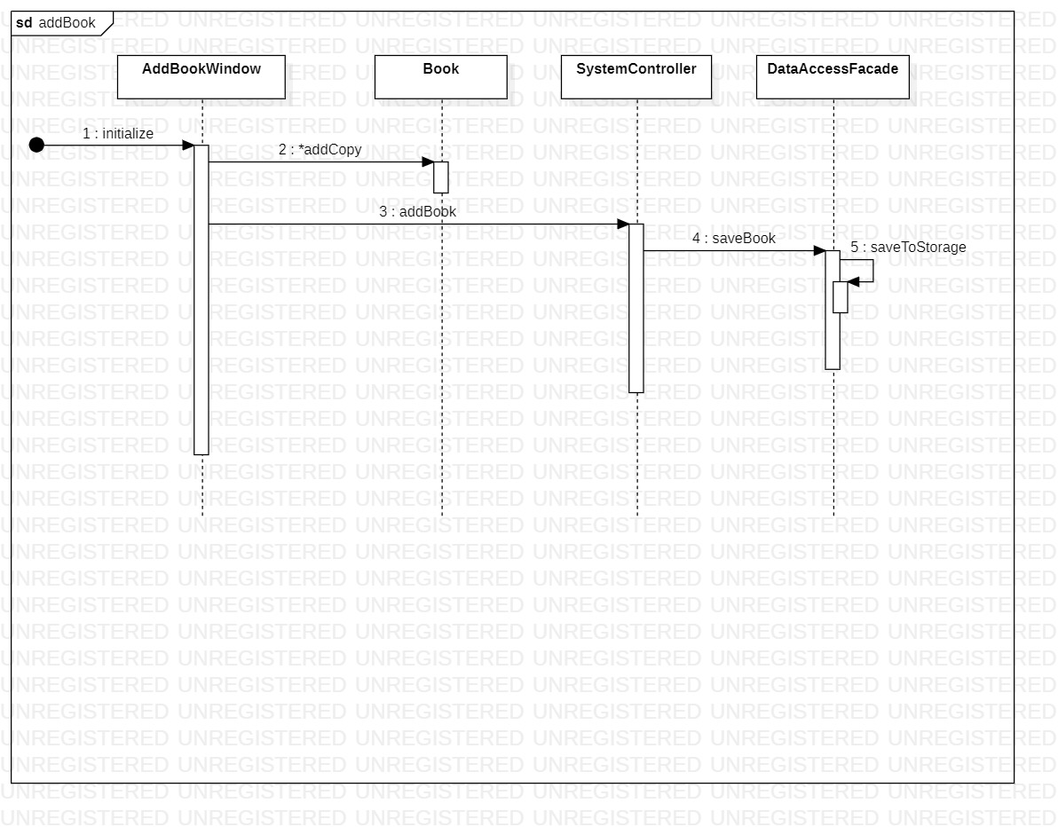

Slide 14
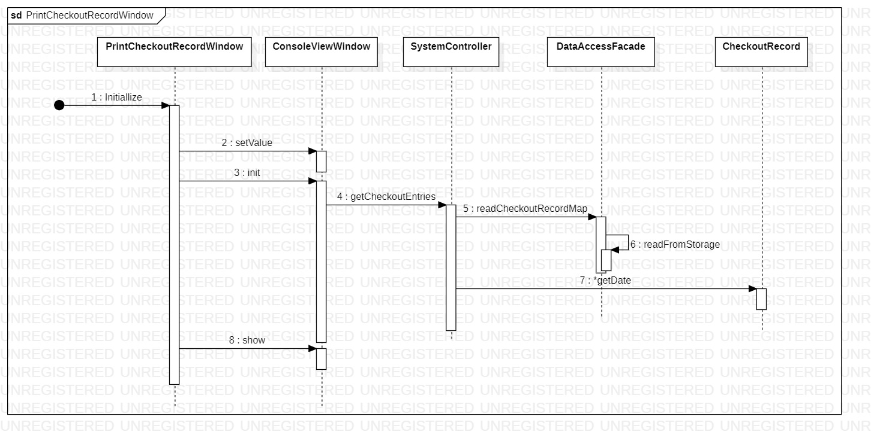

Slide 15
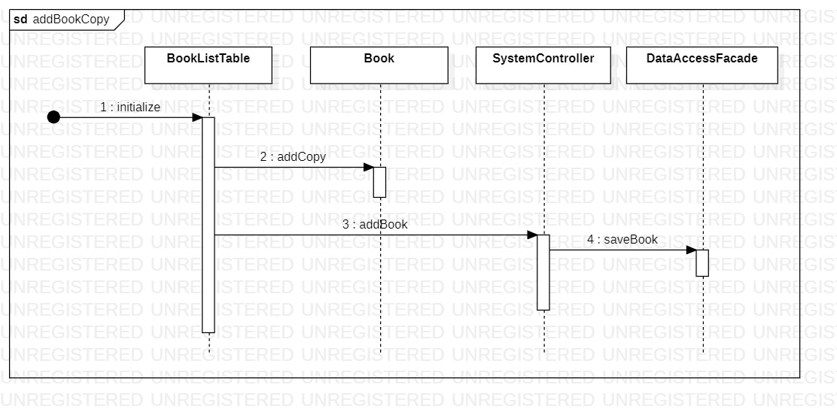

Slide 16
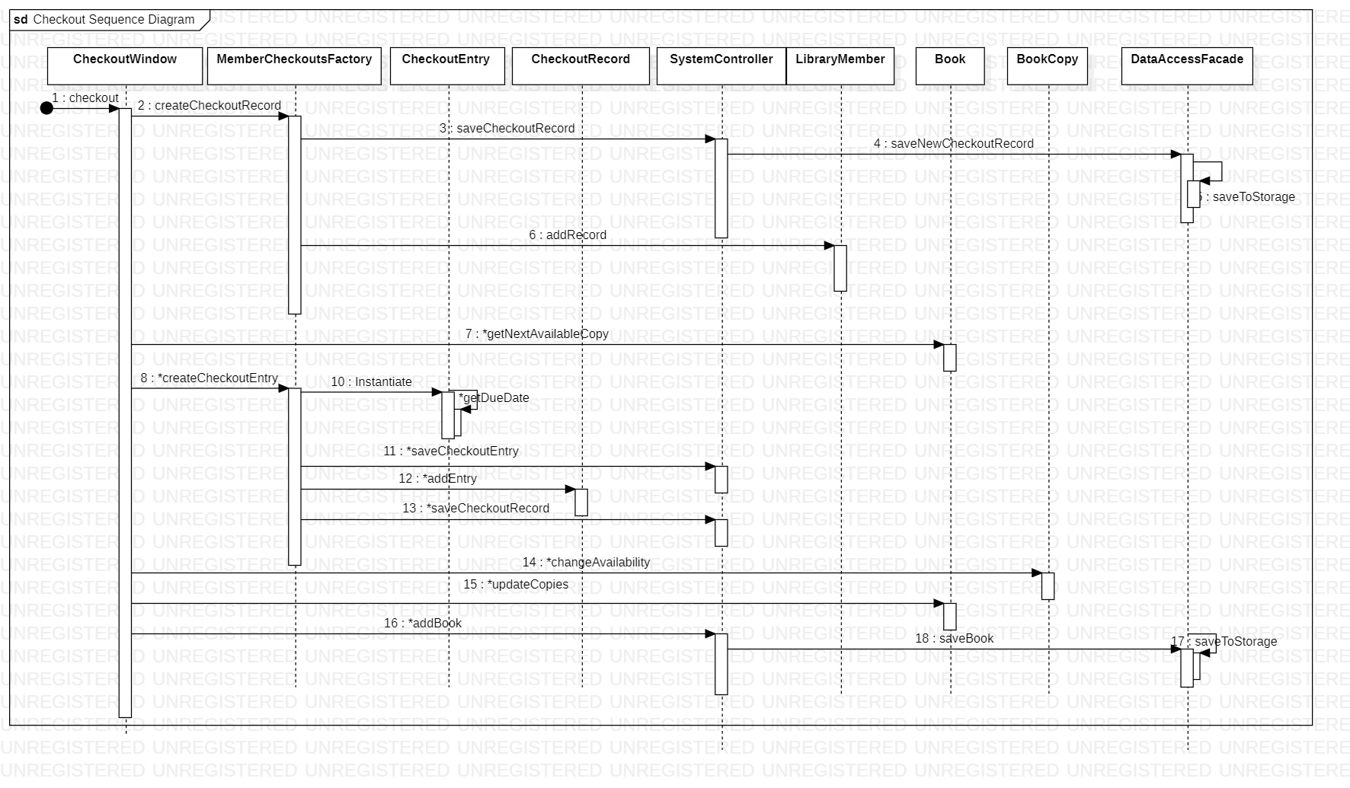

Slide 17

Project Screens

Slide 18
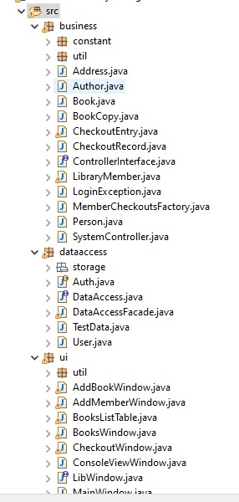
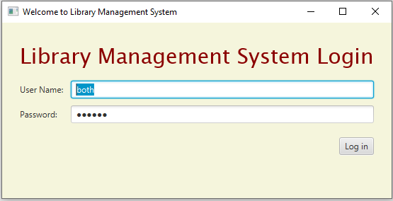
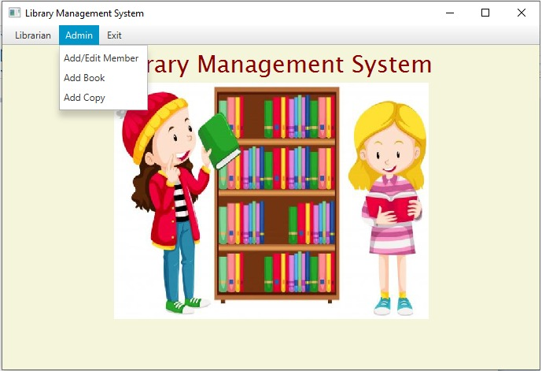
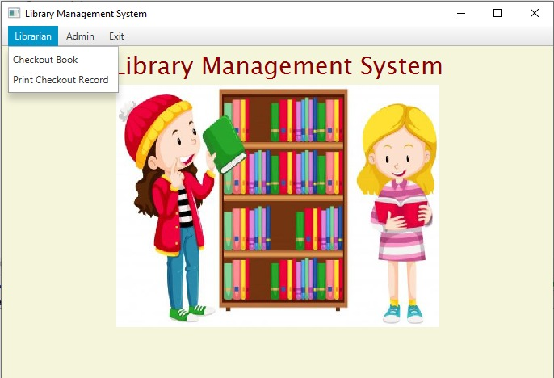

Slide 19
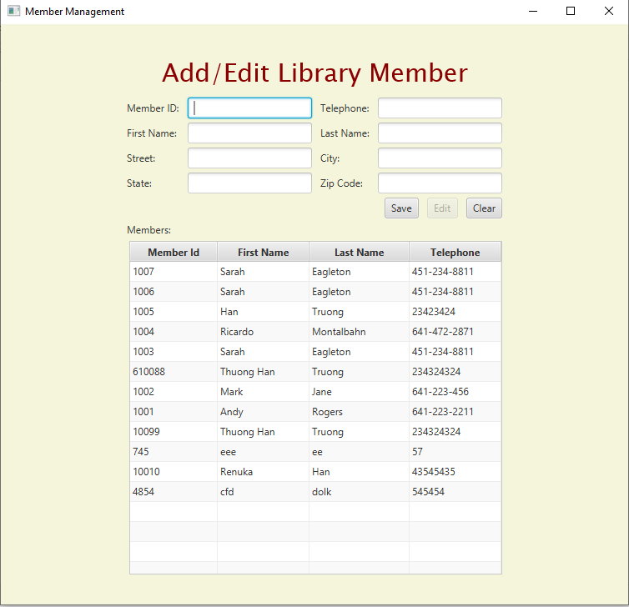
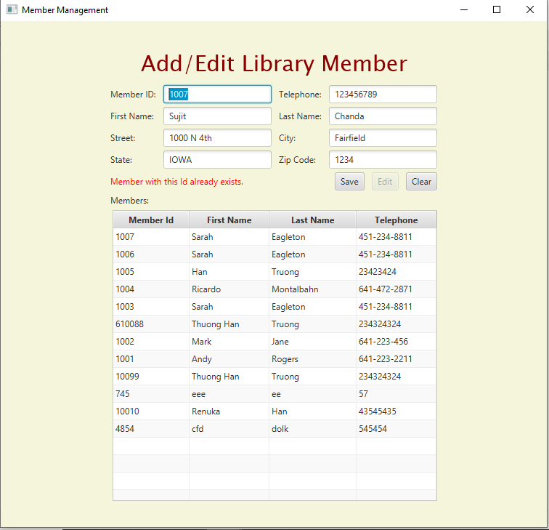

Slide 20
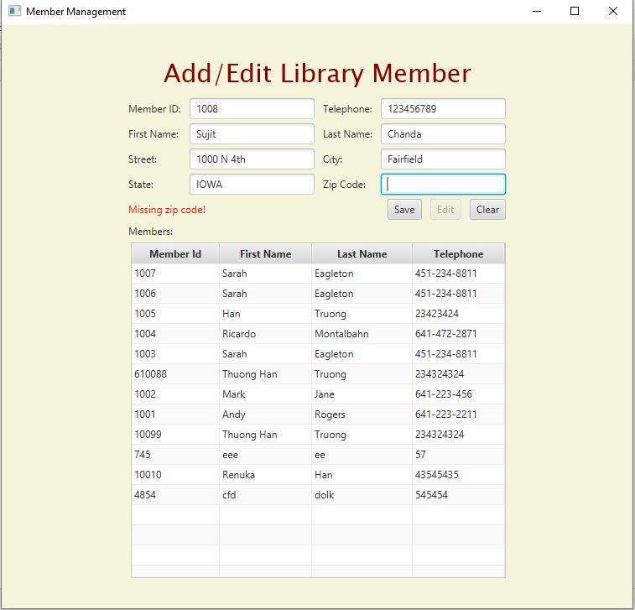
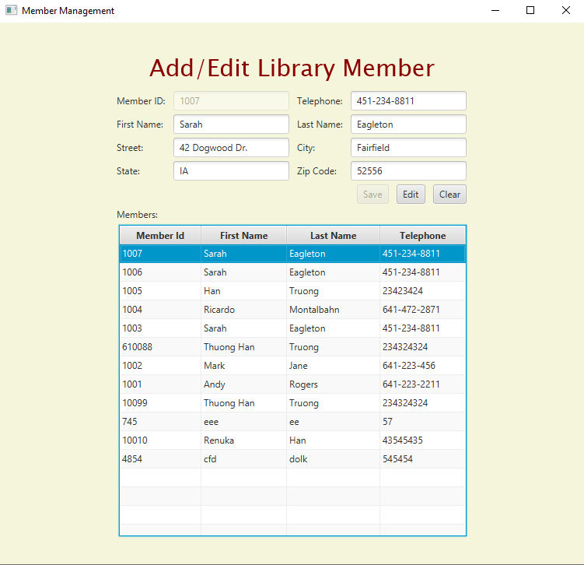

Slide 21
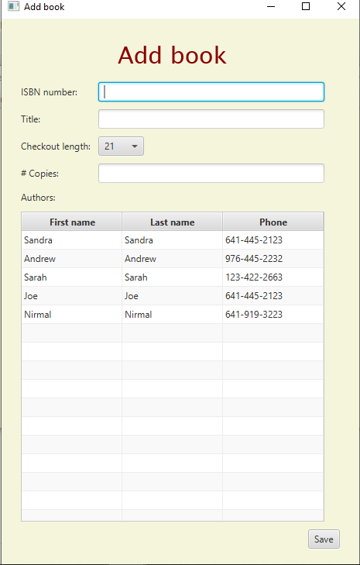
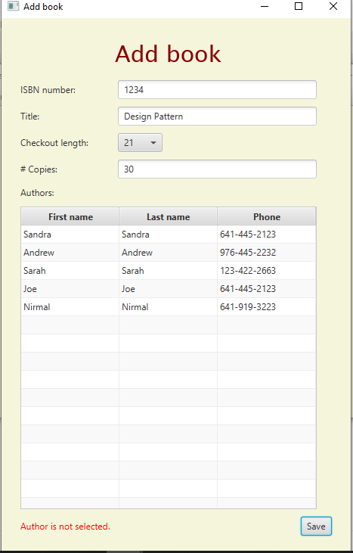
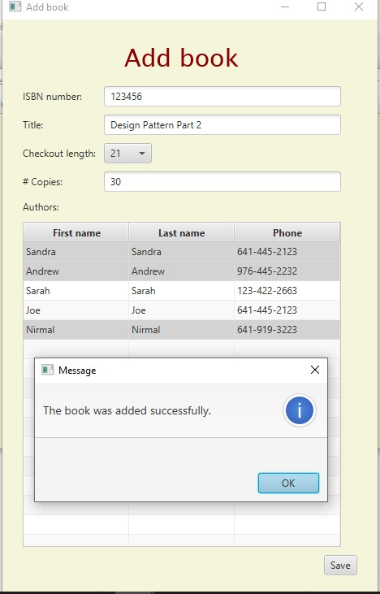

Slide 22
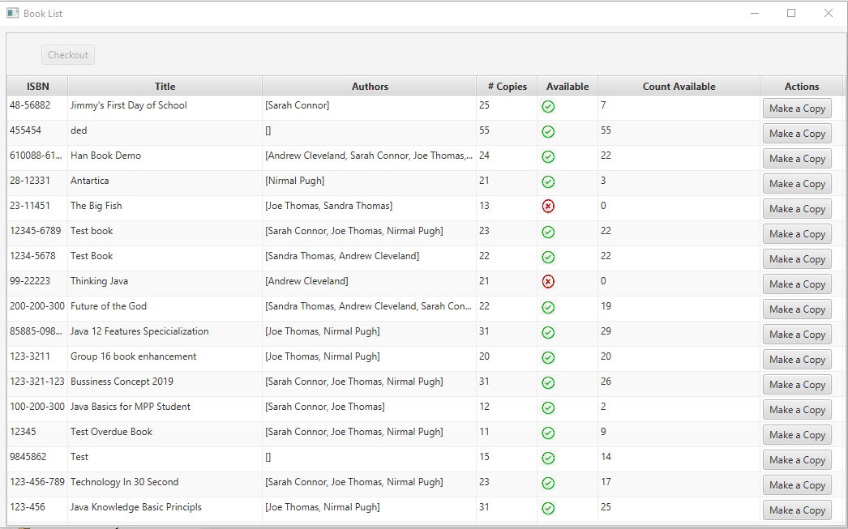
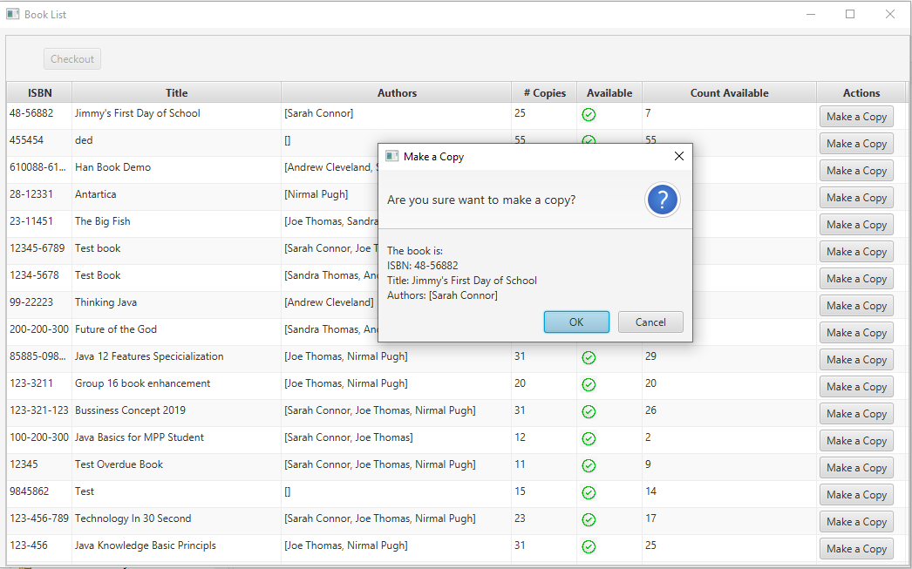
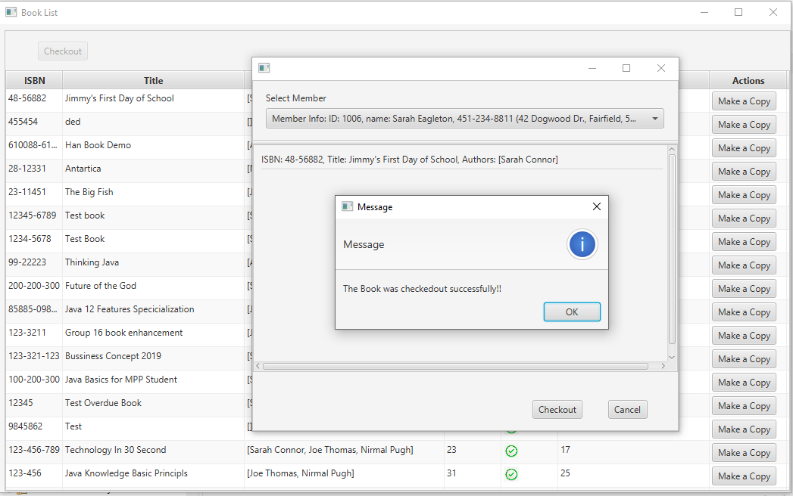
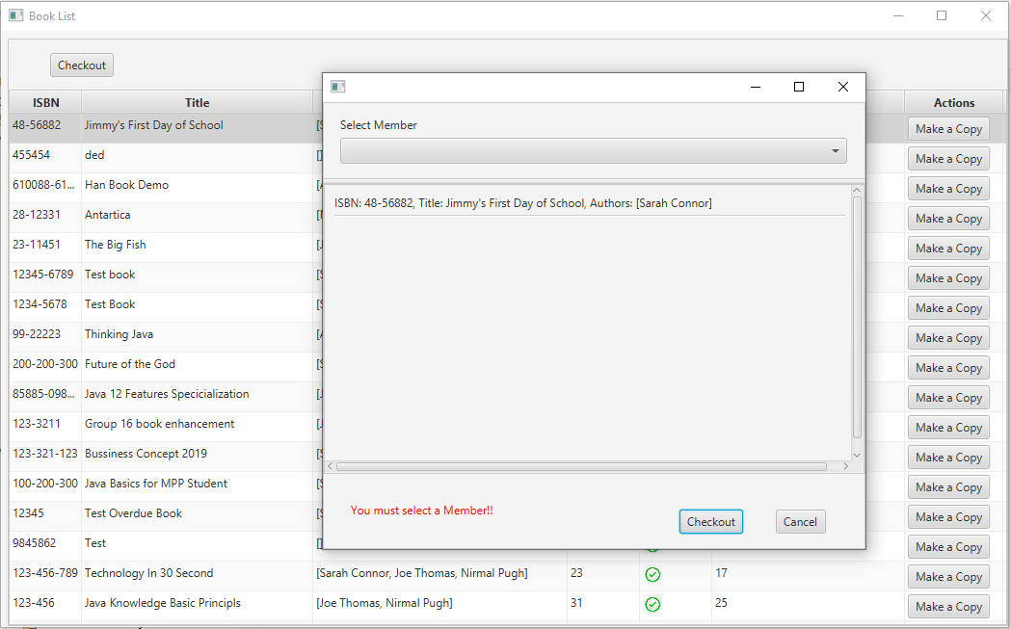

Slide 23
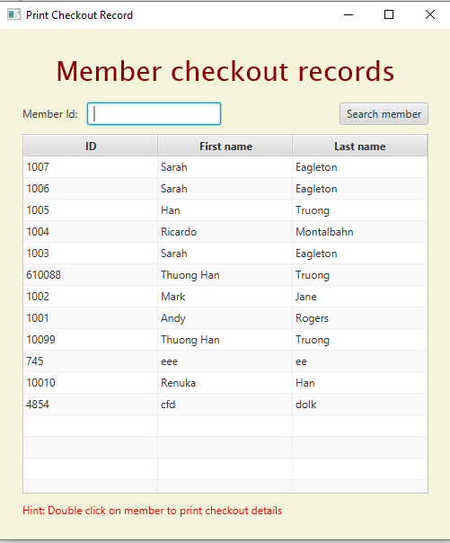
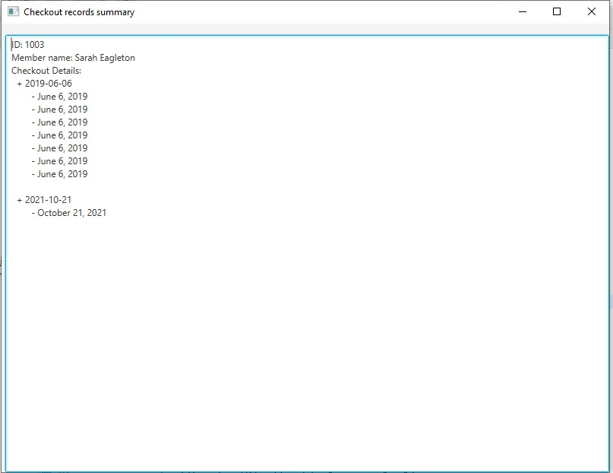

Slide 24
Thanks…

